Slide 1
Brussels real estate study project
IBM Coursera Capstone project
Piotr Zamisnii
Monday, May 11, 2020

Slide 2
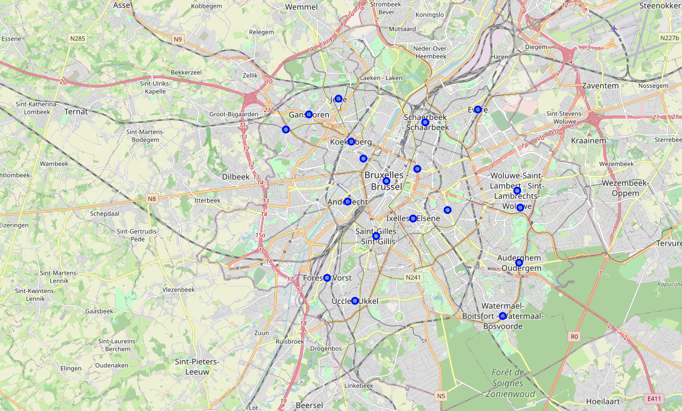
Setting up a problem
Improving the search of an apartment for the foreigner coming to Brussels city based on the venues located in the corresponding district and given the geographical location
Finding the best value for the price and interests of the person in the 19 districts of the city

Slide 3
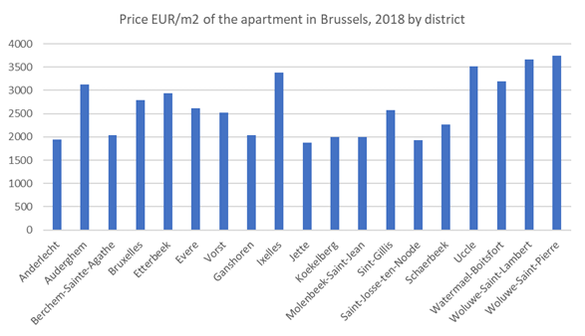
Background data
Brussels is a cosmopolitan city of 1.2 mln inhabitants and spaning over 640 km2
The city is composed of 19 districts which formed the city of Brussels as an administrative unit in 1947
Districts are very different in terms of service offering due to many socio-economical factors and as such, there is a big difference between prices of real estate, both for rent and for sale.
Current prices as of 2018 are indicated in the graph on the slide and vary from 1900 to 3700 EUR per sqm (open data from the Brussels statistics bureau)

Slide 4
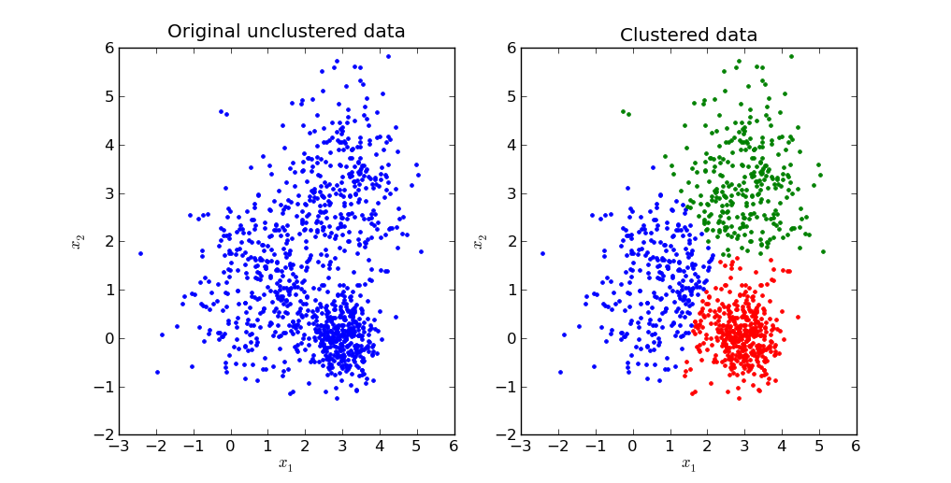
Methodology of the analysis
Data is analysed and processed in several steps:
Downloading and pre-processing the price data for the real estate
Mapping the geographical coordinates to each district
Getting venue data for each district from Foursquare venue database with the radius of 1000m from the center of the commune
Classifying top 10 venues for each district
Performing K-means clustering for each district by main venues
Results will include:
Split of the districts by clusters according to the type of venues
Mapping clusters to the map of Brussels
Drawing conclusions
Discussing the drawbacks, limitations and possible improvements to the analysis

Slide 5
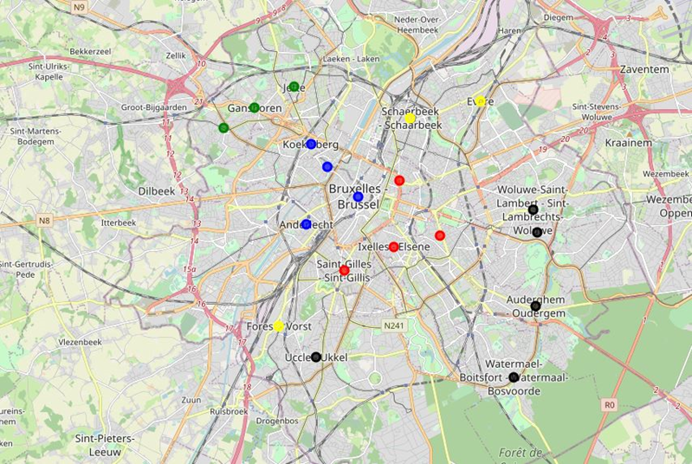
Results of the analysis and clustering
Results of the analysis:
Districts are clustered according to the K-means based on 5 clusters showing the best performance
Districts in clusters are located mostly next to each other which corresponds to the historical development of the city and other trends
In some clusters there are big discrepancies in the prices which could be used to get the best value from the real estate

Slide 6
Main Conclusions
Cluster | District | Price per sqm | Main venues
0 | Woluwe St Pierre | 3750 | Italian and French Restaurants, Parks, Bakery, Gastropub
 | Auderghem | 3130
 | Watermael Boitsfort | 3190
 | Uccle | 3520
 | Woluwe St Lambert | 3660
1 | Molenbeek | 2000 | Bar, Hotel, Plaza, Brewery
 | Koekelberg | 2000
 | Anderlecht | 1940
 | Bruxelles | 2790
2 | Ixelles | 3380 | Plaza, Coffee shop, bar
 | Etterbeek | 2940
 | Sint Gillis | 2570
 | Saint-Josse-ten-Noode | 1930
3 | Vorst | 2520 | Bar, Snack place, supermarket
 | Evere | 2610
 | Schaerbeek | 2260
4 | Berchem St Agathe | 2040 | Bar, Pizza place, Chinese restaurant
 | Ganshoren | 2040
Cluster 0 - is a posh area where there are mainly high-level restaurants with French and Italian cuisine, parks and gastropubs which make them a perfect place to live for middle class 40+ population.
Cluster 2- for young professional looking to spend some time to go out in the weekends, as there are number of pubs and coffee shops in those areas whereas the price for the real estate is rather comfortable.
Cluster 3 - if you have a family and you might want the proximity of large supermarkets, with the district of Schaerbeek offering a good value.

Slide 7
DRAwBACKs and next steps for potential improvement
This study of course is just a first look at the problem of selection of the ideal place to stay in Brussels. Due to the limitation of the data, the following could be done to improve the analysis:
Incorporate the venues rating in the analysis to have a selection of top choice
Extend the selection of venues not only to the radious of 1000 meters from the center of the district but to include all the venues with a specific project code
Group venues into larger segments and perform the analysis on the broader groups.

